Slide 1

DeFiGuardian AI: The Future of Risk Management in DeFi
Welcome to DeFiGuardian AI - the next generation of risk management in decentralized finance. Imagine having an AI assistant that monitors your investments 24/7, automatically executes hedging strategies, and protects your portfolio against catastrophic losses. This isn't science fiction anymore - it's reality.
Our solution combines advanced artificial intelligence with smart contracts to create the first complete DeFi protection system. While 90% of investors lose money in DeFi due to extreme volatility and inadequate risk management tools, DeFiGuardian AI stands as your vigilant protector in the chaotic world of decentralized finance.
Explore our project at:
https://github.com/uederson-ferreira/defiguardian-ai
https://defiguardian-ai.vercel.app/
por Uederson Ferreira

Slide 2

The DeFi Risk Management Crisis
The DeFi market moves billions of dollars daily, but a startling 90% of investors lose money due to a lack of adequate risk management tools. This represents not just a problem, but a crisis in the ecosystem:
Extreme Volatility
24/7 Markets
Digital assets can experience price swings of 20%+ in a single day, catching unprepared investors in devastating liquidations and impermanent loss scenarios.
Unlike traditional markets, DeFi never sleeps. This creates constant monitoring requirements that are impossible for human traders to maintain.
Without proper risk management tools, DeFi portfolios are vulnerable to sudden market movements, protocol exploits, and impermanent loss - often resulting in devastating financial consequences.
Complex Protocols
The intricate interactions between lending, yield farming, and liquidity protocols create risk vectors that are difficult to identify and mitigate manually.

Slide 3




Our Solution: AI-Powered Risk Management
AI Analysis
ElizaOS powers our specialized financial risk AI agent, leveraging the DeepSeek R1 model to provide sophisticated market analysis and personalized recommendations based on your specific risk profile.
Automated Protection
Smart contracts execute protective measures automatically when threats are detected, including stop-losses, portfolio rebalancing, and cross-chain hedging strategies to prevent catastrophic losses.
Conversational Interface
Interact with your financial guardian through natural language. Ask questions about your portfolio, request risk assessments, or activate protection strategies with simple conversational commands.
DeFiGuardian AI democratizes access to sophisticated risk management strategies previously available only to large financial institutions, making them accessible to every DeFi participant through an intuitive, conversational interface.
Our solution is available at https://defiguardian-ai.vercel.app/ with full source code at https://github.com/uederson-ferreira/defiguardian-ai.

Slide 4
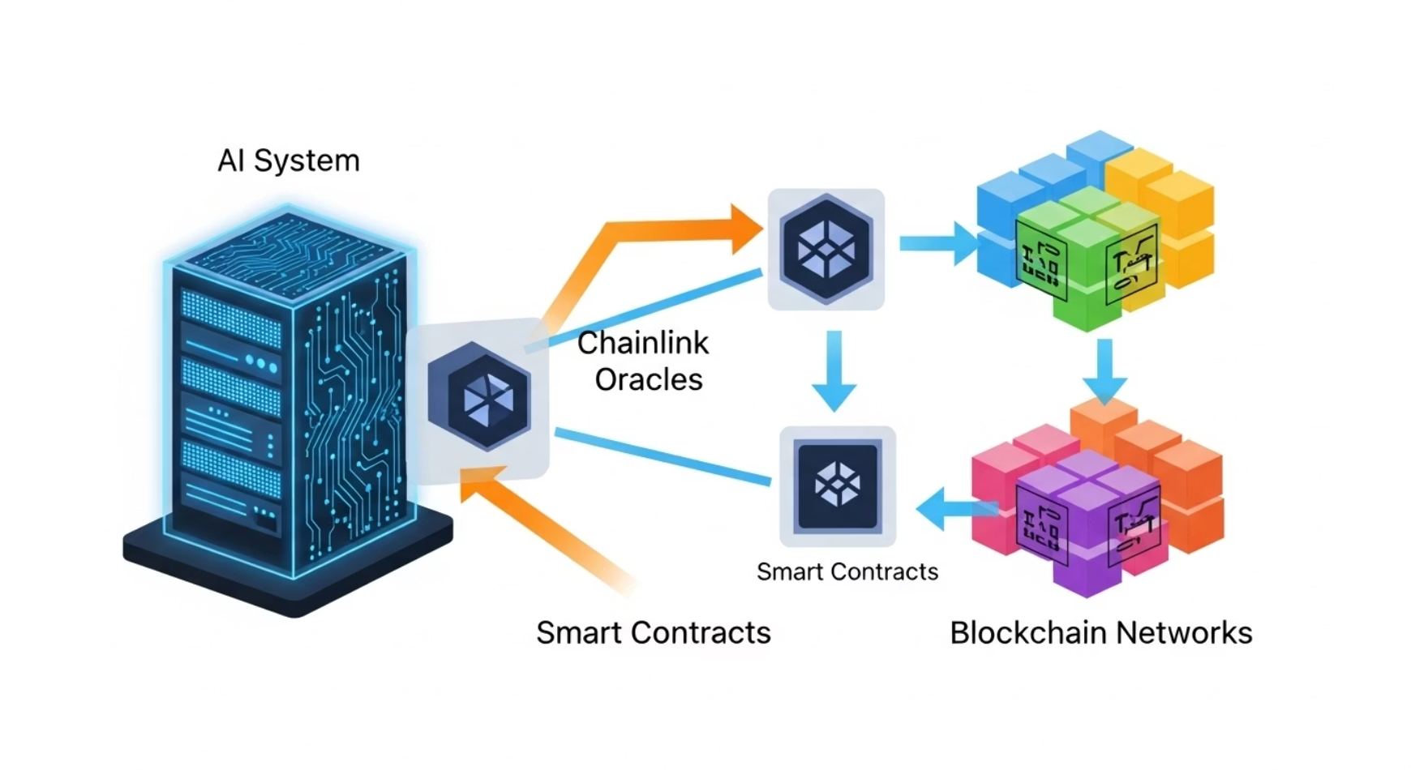



Technical Architecture: The Guardian's Framework
Robust Multi-Layer Technology Stack
DeFiGuardian AI combines cutting-edge AI with blockchain technology to create a comprehensive risk management system:
ElizaOS AI Framework
Specialized financial risk agent built on ElizaOS, integrated with OpenRouter for advanced natural language processing and utilizing the DeepSeek R1 model for precise financial analysis and intelligent responses.
Multi-Chain Integration
27 smart contracts deployed on Avalanche Fuji Testnet with cross-chain capabilities via Chainlink CCIP, providing native support for AVAX, ETH, and major DeFi tokens across multiple networks.
Deployment Status
✅ 27 contracts deployed on Avalanche Fuji
✅ Functional frontend with interactive dashboard
Chainlink Infrastructure
✅ Active ElizaOS agent providing responses
✅ Complete Chainlink integration
Leveraging Chainlink's decentralized oracle network for real-time price feeds, Automation for trustless strategy execution, and CCIP for secure cross-chain operations and capital efficiency optimization.
✅ Stress tests passed with 99.9% uptime
This sophisticated architecture enables DeFiGuardian AI to monitor market conditions, analyze portfolio risk, and execute protective strategies with minimal latency - all while maintaining a simple, conversational interface for users of all experience levels.

Slide 5




Key Features: Your DeFi Safety Net
Intelligent Protection System
Multi-layered defense including automated stop-loss execution, dynamic portfolio rebalancing based on market conditions, and volatility hedging strategies that adapt to changing risk environments.
Conversational AI Assistant
Natural language portfolio analysis, personalized recommendations based on risk profile, proactive alerts about opportunities and threats, and detailed explanations of all operations in plain language.
Cross-Chain Optimization
Pioneering cross-chain hedging strategies with automatic arbitrage between Ethereum and Avalanche, risk diversification across blockchains, cross-chain emergency exits, and gas fee optimization.
Real-Time Analytics
Comprehensive risk metrics, interactive performance tracking, exposure analysis, and intelligent suggestions for portfolio improvements based on current market conditions and historical patterns.
These features work in concert to provide comprehensive protection for DeFi investments, whether you're a beginner with $1,000 or an institution managing millions. The system automatically adjusts its strategy recommendations based on your risk tolerance, investment goals, and market conditions.
Experience these features firsthand at https://defiguardian-ai.vercel.app/

Slide 6



Real-World Use Cases: For Every DeFi Participant
For Beginners
For Advanced Traders
For Institutions
Maria has $1,000 in DeFi but doesn't understand risk management. With DeFiGuardian AI, she simply says: "Protect my investment" and the system automatically configures appropriate stop-losses and diversification strategies.
João manages $100k across multiple protocols. Our system monitors 24/7 and executes complex hedging strategies he's configured, freeing his time for analyzing new opportunities while protecting his existing positions.
DeFi funds can integrate our API for automated risk management operations, significantly reducing drawdowns and improving Sharpe ratios through sophisticated hedging and cross-chain capital optimization.
Simple natural language interface
Custom strategy configuration
Enterprise API integration
Automatic protection setup
24/7 automated execution
Custom risk parameters
Educational explanations
Multi-protocol monitoring
Advanced analytics dashboard
Beginner-friendly alerts
Sophisticated cross-chain hedging
Institutional-grade security
In each case, DeFiGuardian AI adapts its approach to the user's knowledge level, portfolio size, and risk tolerance - providing appropriate protection without overwhelming complexity for beginners or limiting flexibility for experts.
Our project repositories are available at https://github.com/uederson-ferreira/defiguardian-ai for technical evaluation.

Slide 7
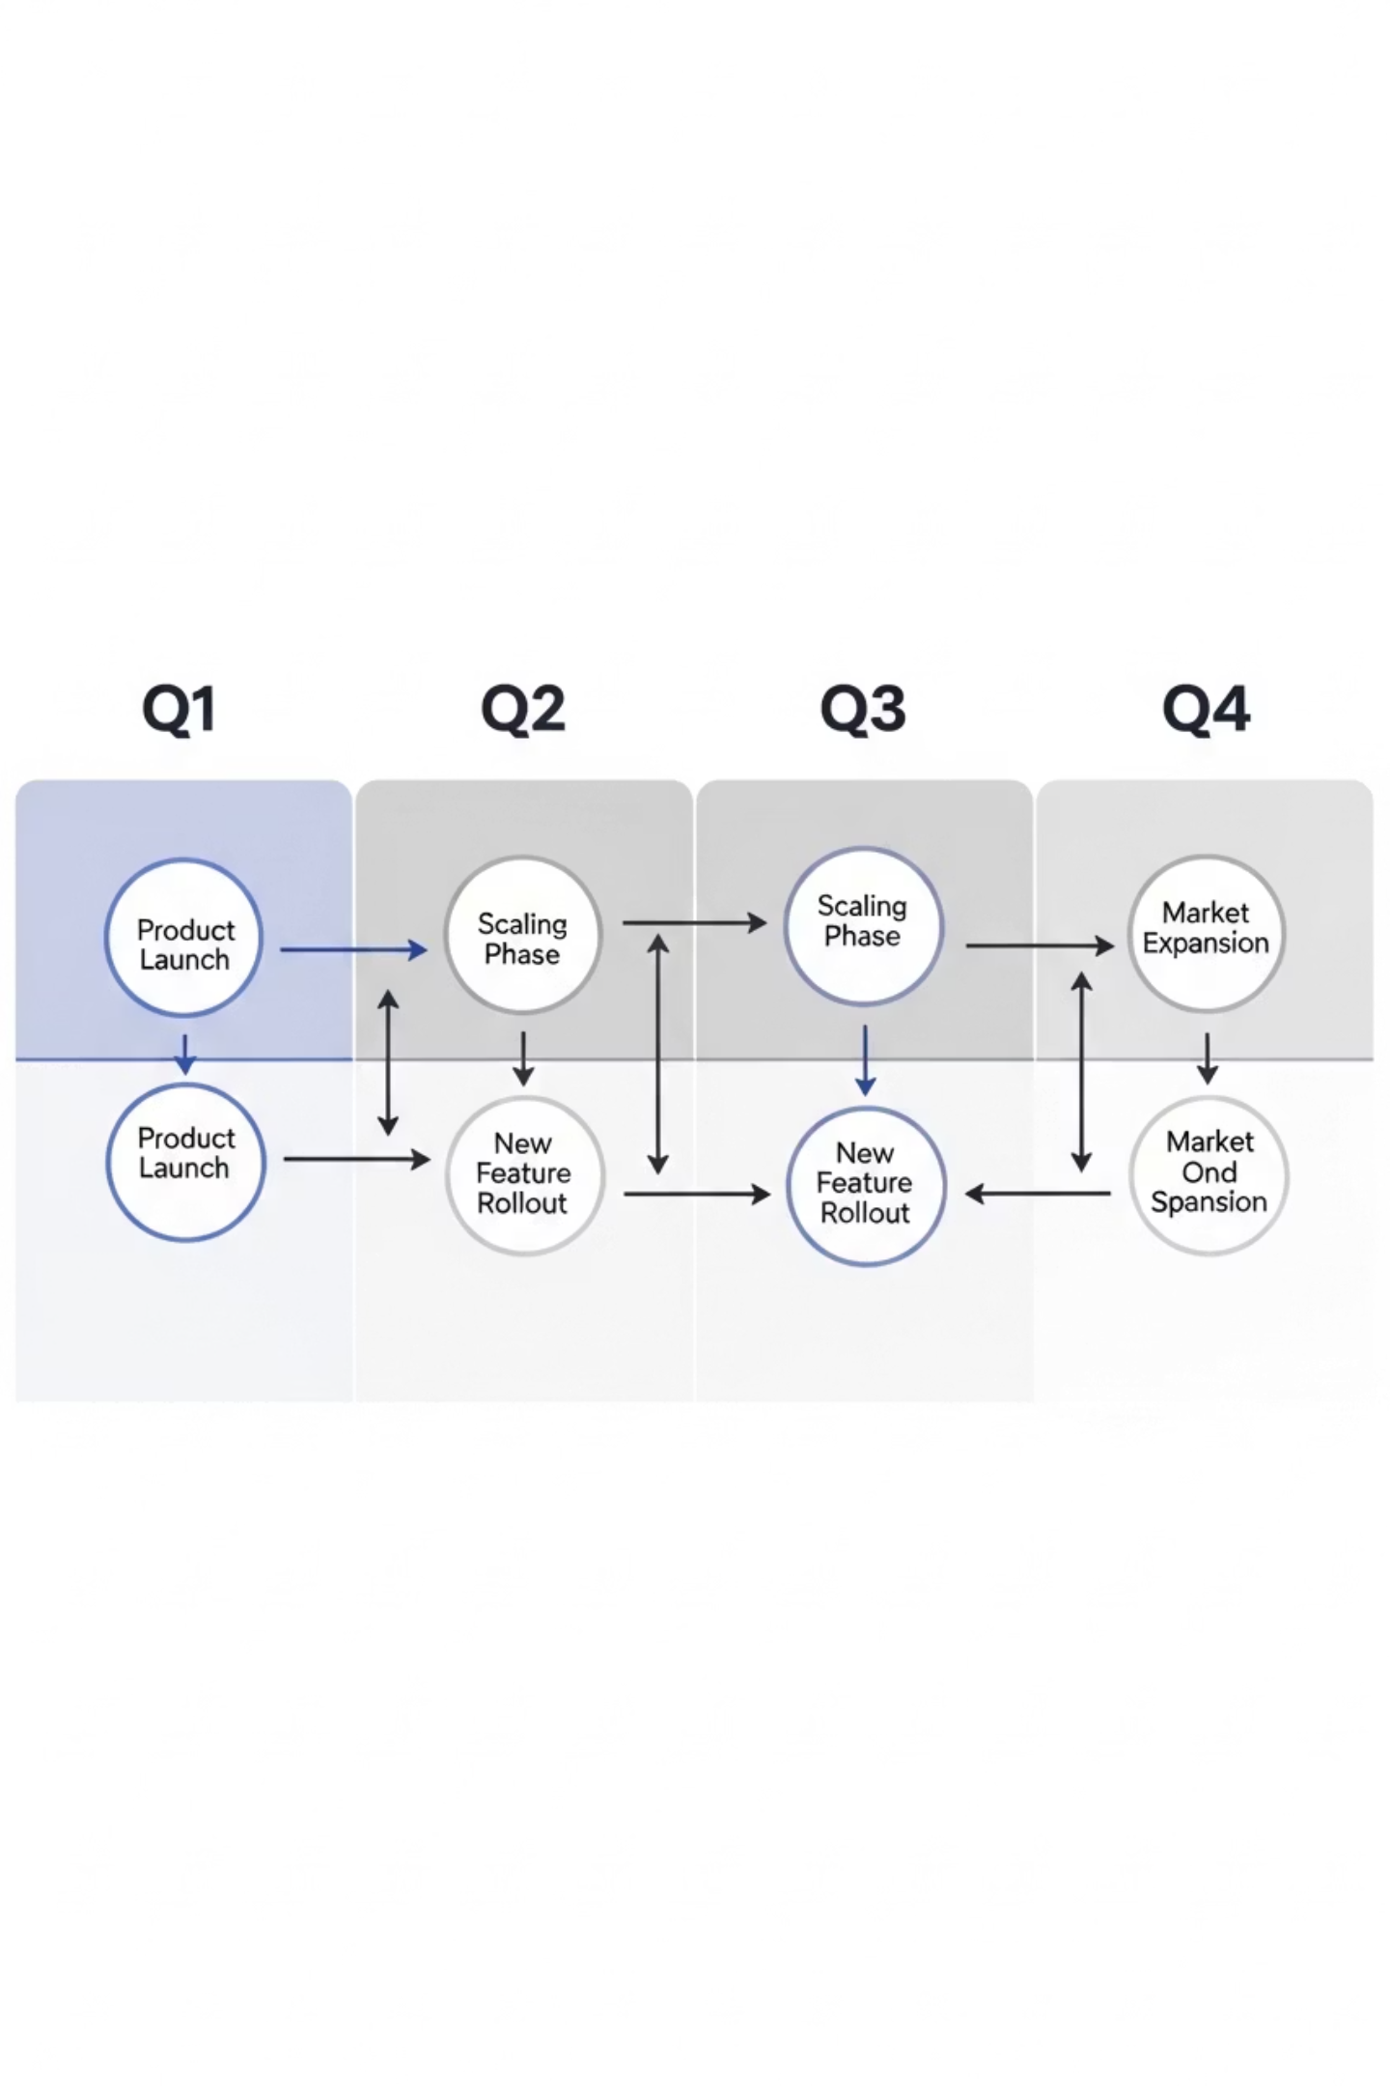
Roadmap: The Path Forward
1
Q1 2024
Deploy on Avalanche Mainnet
Integrate with Aave, Compound and Uniswap V3
Launch mobile version with push notifications
Expand risk analysis capabilities
2
Q2 2024
Expand to Polygon and Arbitrum networks
Launch hedging strategy marketplace
Introduce governance token and staking
Advanced portfolio visualization tools
3
Q3 2024
TradFi integration via Chainlink Functions
AI-powered yield optimization engine
Institutional API and white-label solutions
Advanced risk-scoring for DeFi protocols
Business Model
10%
$29
$10K
Performance Fee
Monthly Premium
Enterprise License
Percentage of profits generated through our automated hedging and optimization strategies, aligning our incentives with user success.
Subscription fee for advanced features including custom strategy configuration, priority AI assistance, and enhanced analytics dashboard.
Annual licensing for institutional clients including dedicated support, custom API integration, and white-label solutions.
0.5%
Insurance Fee
Small percentage of insured value for participation in our collective protection pool, providing additional security for catastrophic events.
Our roadmap represents a strategic expansion of capabilities while our business model ensures sustainable development and alignment with user interests.

Slide 8


Join the DeFi Risk Revolution
"DeFiGuardian AI isn't just a tool - it's the future of risk management in DeFi. We're combining the best of artificial intelligence, blockchain, and automation to create a solution that protects, optimizes, and educates."
We're democratizing access to sophisticated risk management strategies that were previously available only to large financial institutions. The future of decentralized finance is intelligent, automated, and secure - and that future is now.
Experience DeFiGuardian AI Today
Test our live demo, chat with our AI agent, and see how we can protect your DeFi investments. Zero risk doesn't exist, but intelligent risk management does.
DeFiGuardian AI - Protecting the future of decentralized finance, one transaction at a time.

